Slide 1
Protein Backbone Search and Design
Tianyu Lu
September 10, 2020
Kim Lab

Slide 2
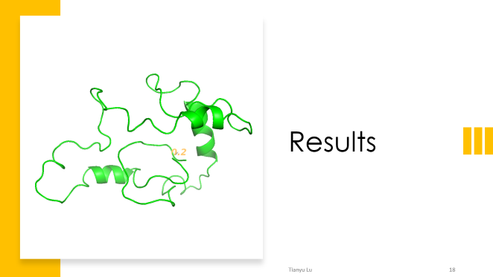
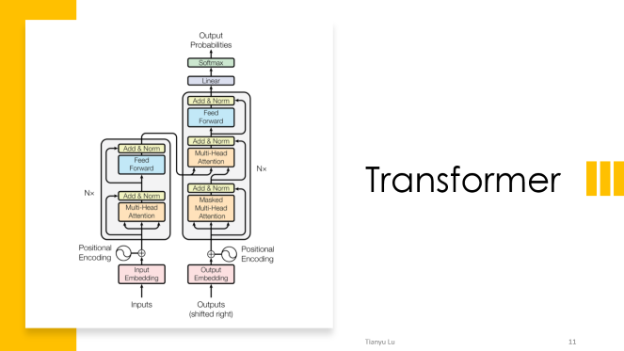
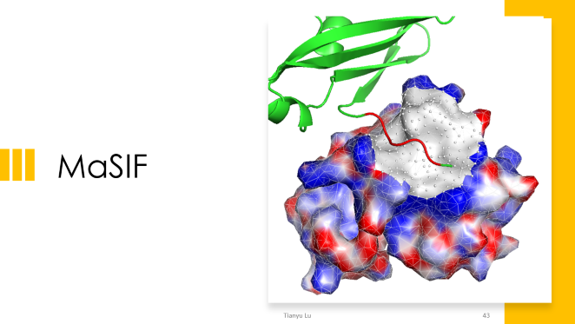
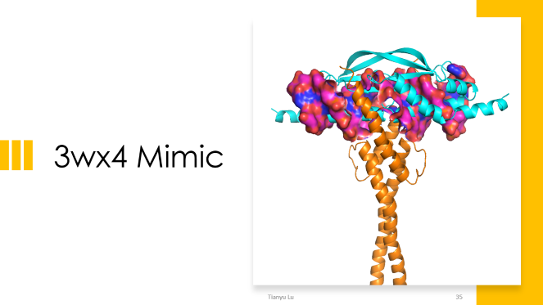
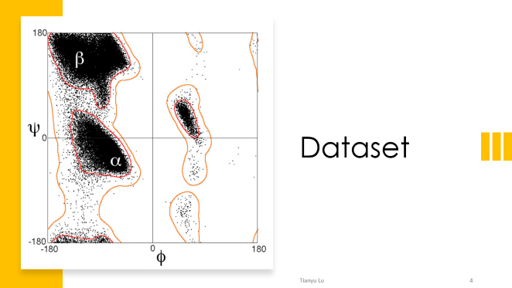
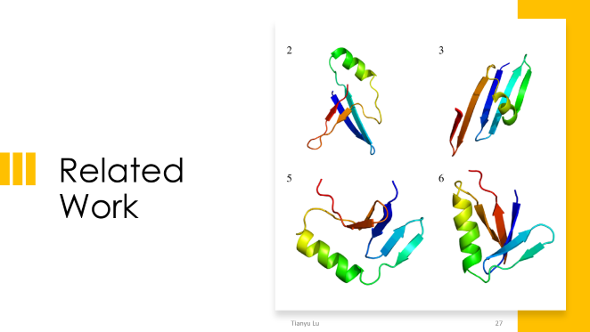
Content

Slide 3
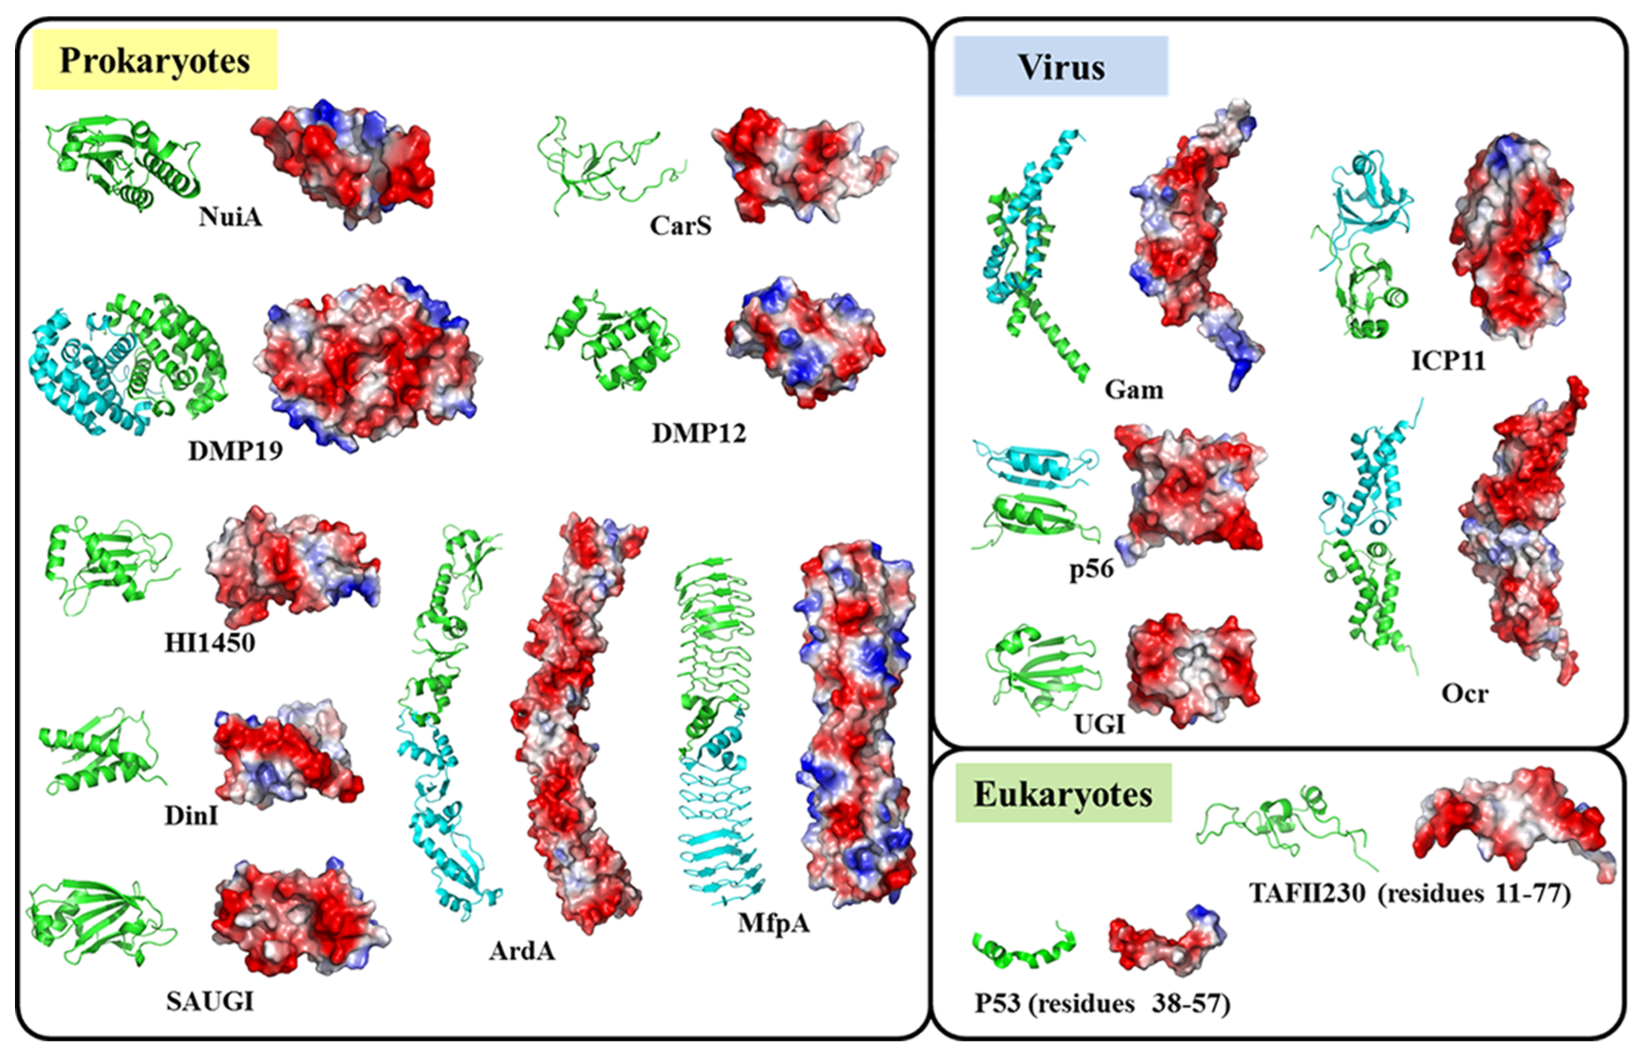
DNA Mimic Proteins: Next Steps
Run proteinsolver on the Myc-Max DNA binding structure
Synthesize designs with mutations at proposed sites to assess folding in vitro
Consider other scaffolds
Use generative model to sample from distribution over protein structures biased towards DNA mimic proteins
Try other DNA mimic proteins

Slide 4
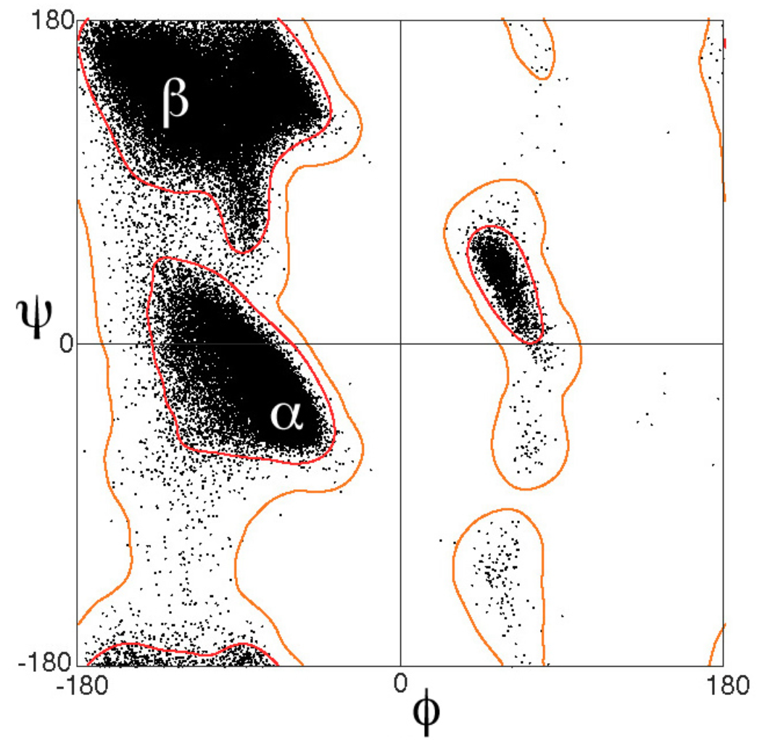
Dataset
Notes:
http://bioinformatics.org/molvis/phipsi/
https://en.wikipedia.org/wiki/Ramachandran_plot#/media/File:Ramachandran_plot_general_100K.jpg

Slide 5
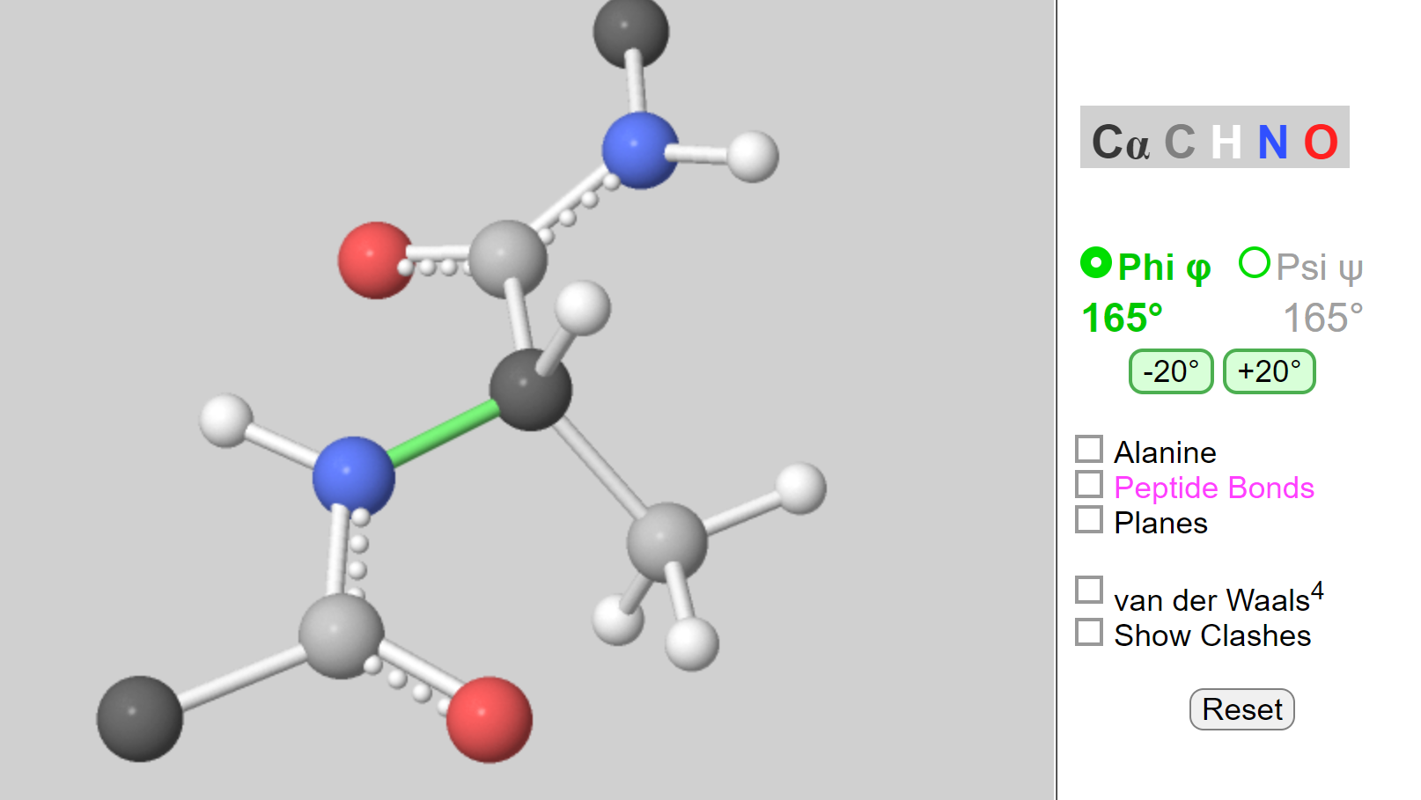

Slide 6
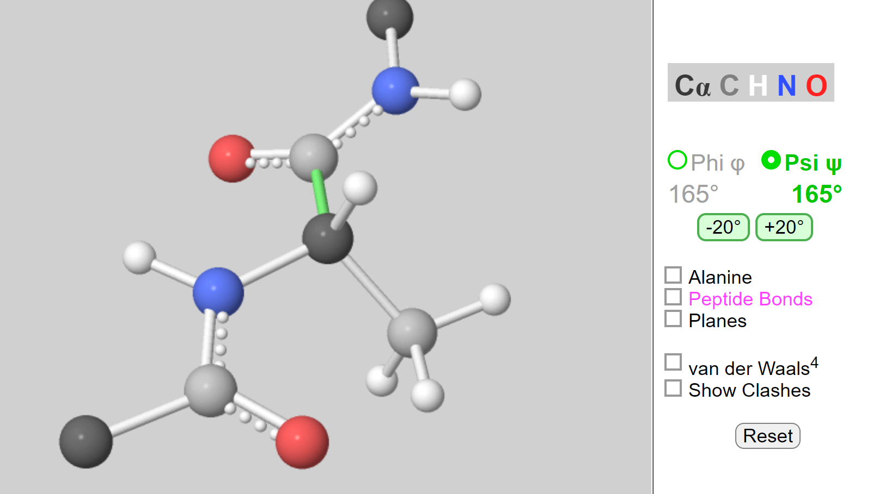

Slide 7
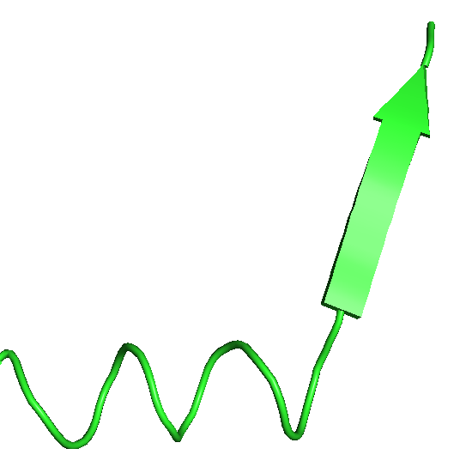
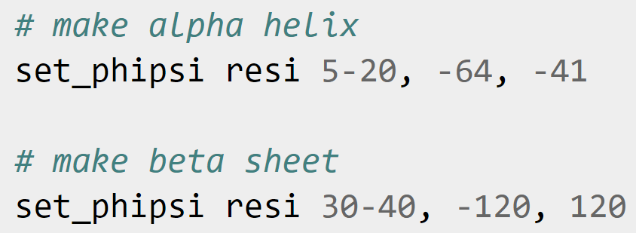
Making Helices and Sheets
How to generalize?

Slide 8
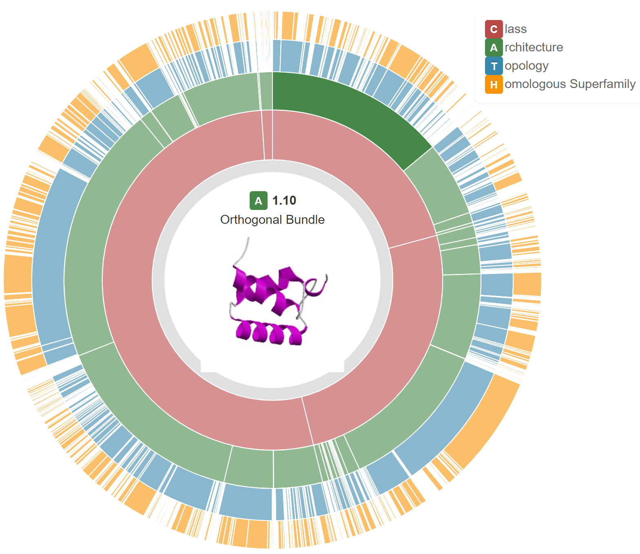
Dataset
CATH version 4.2
C: Class
A: Architecture
T: Topology
H: Homology
1.10
59,961 structures
90% training
10% validation

Slide 9
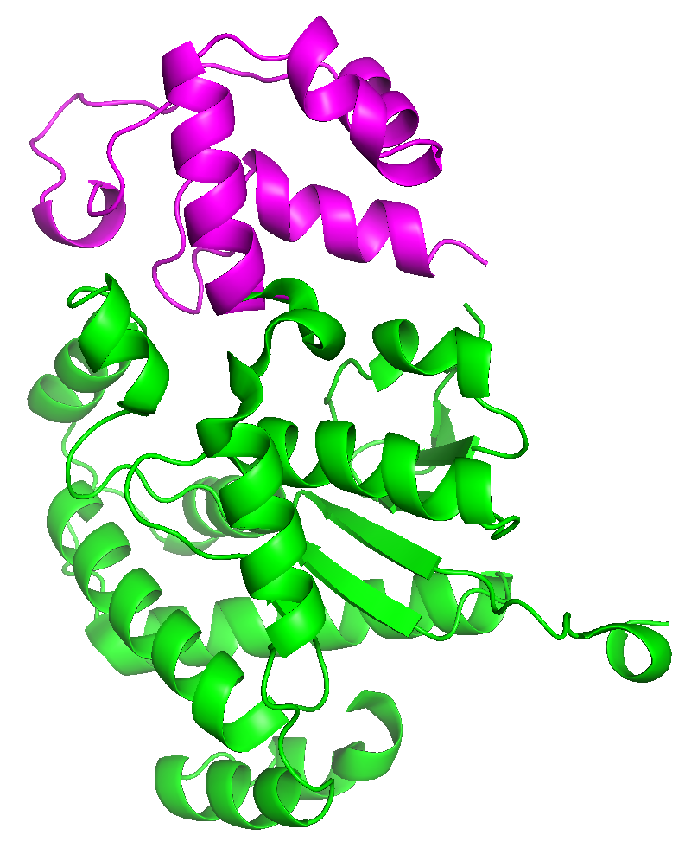
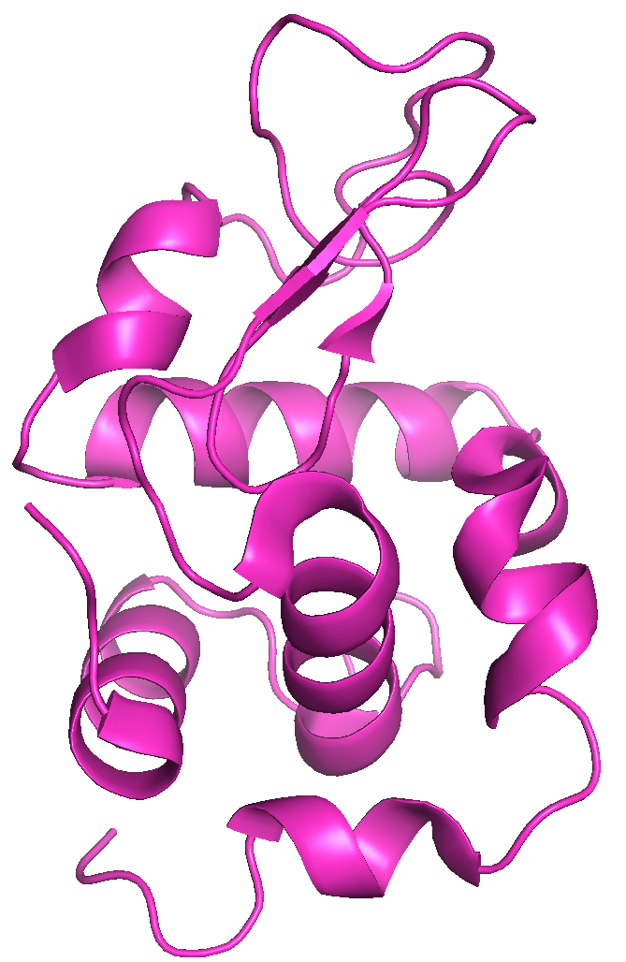
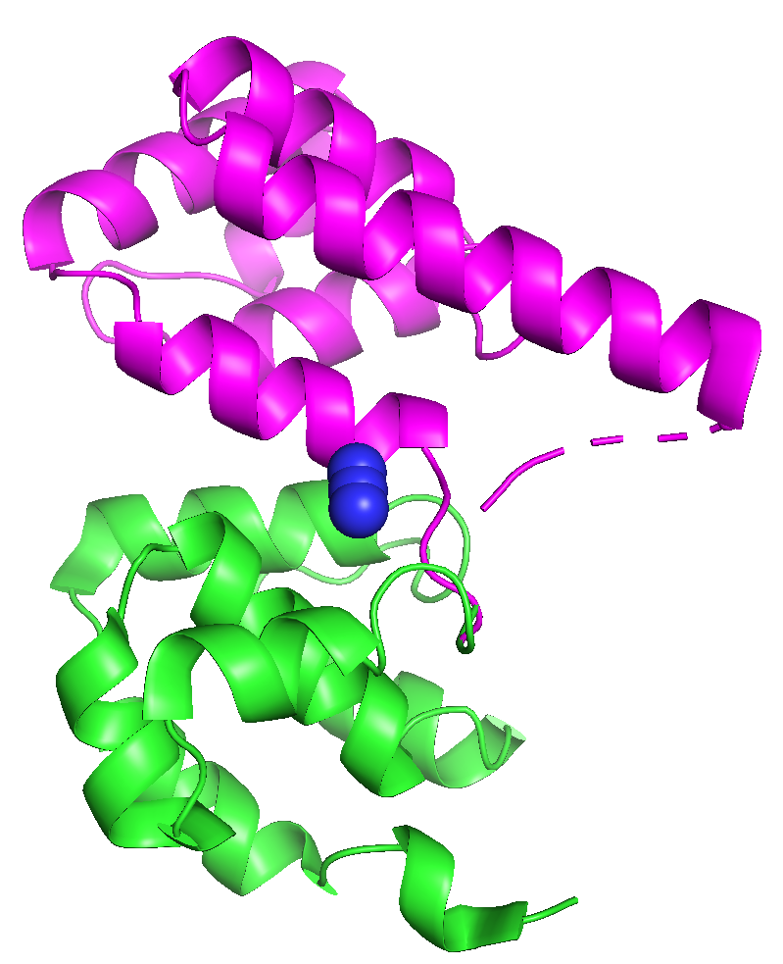
CATH 1.10 – Orthogonal Bundles
2bbrA02-death-domain
2vb1A00-lysozyme
3h7iA02-dna-polymerase

Slide 10

Transformer
Notes:
http://bioinformatics.org/molvis/phipsi/

Slide 11
Transformers
Designing a protein is simple!
1.
~~Create a template for your protein.~~
2. ~~Make sure your template is a perfect structure.~~
3. ~~Choose an amino acid profile that is to be used by our protein.~~
4. ~~Once you have your template all set up, begin the research and data collection process!~~
Adding Gluten
Now that you have your template ready to go, you need to add in the gliadin of wheat.
To add the gliadin, follow the directions in the following excerpt. Don't forget to check the highlighted part! (You may need to move your mouse over the glossary icons at the end
Notes:
From https://talktotransformer.com/

Slide 12
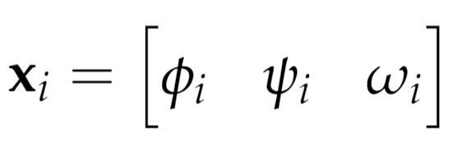
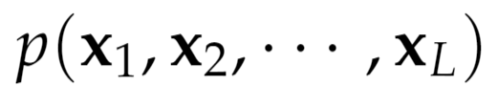
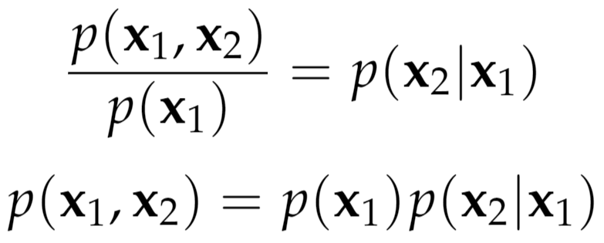
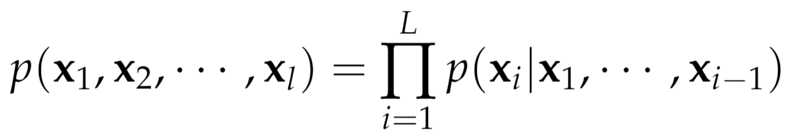
Autoregressive Model
Goal is to model
where
Can factor as

Slide 13

Transformer Architecture

Slide 14
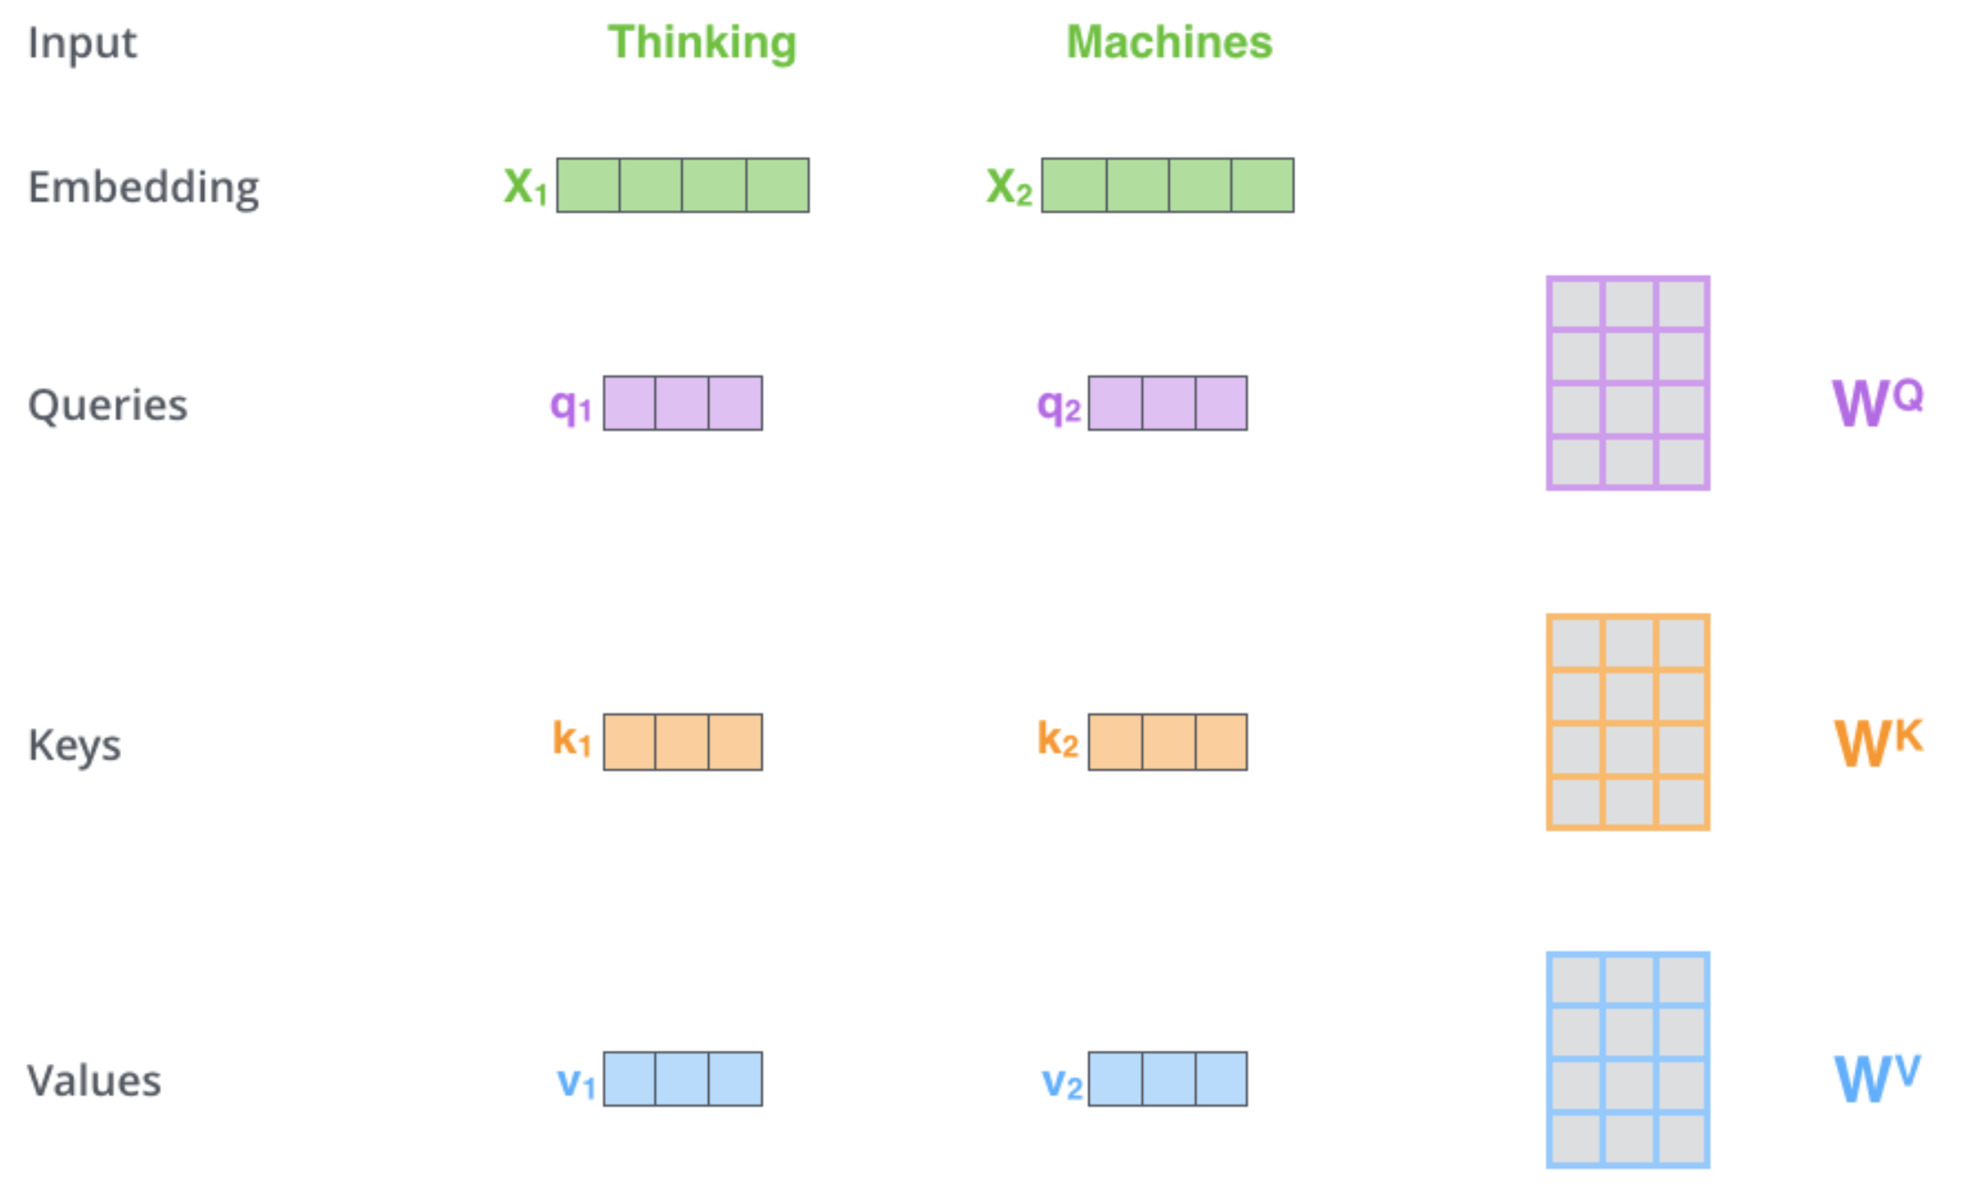
Encoder
Credit: Jay Alammar

Slide 15
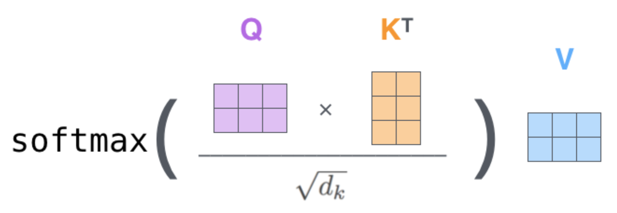
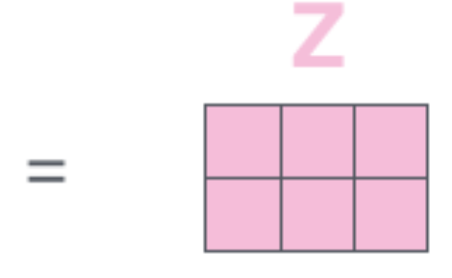
Attention
Credit: Jay Alammar

Slide 16

Decoder
Credit: Jay Alammar

Slide 17
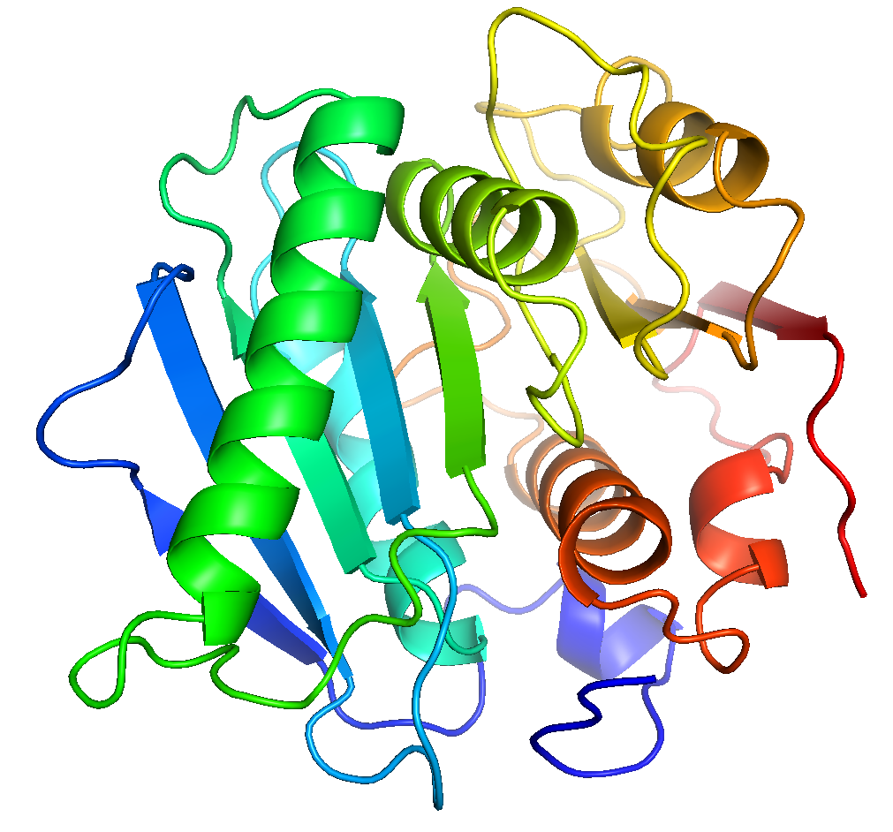
Modified Architecture
HIS-32: ( -135.3, 57.9 ) MET-33: ( -69.5, 134.3 ) ARG-34: ( -133.5, 141.8 ) GLY-35: ( 86.3, 174.5 ) PRO-36: ( -78.5, 167.5 ) ASN-37: ( -62.5, 128.1 ) … … …

Slide 18
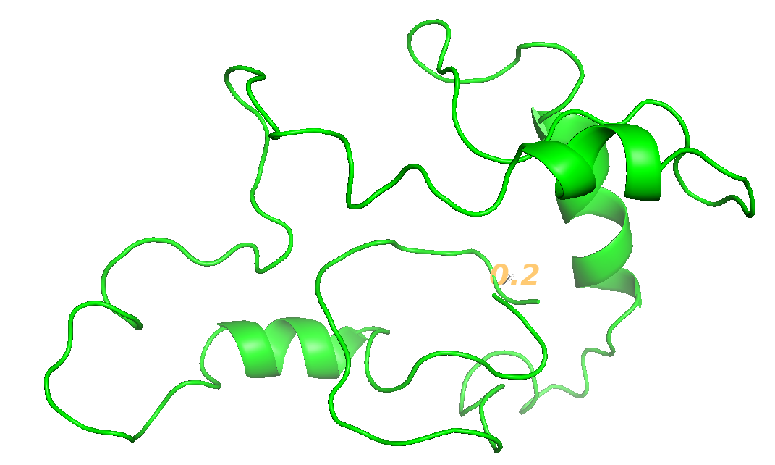
Results
Notes:
http://bioinformatics.org/molvis/phipsi/

Slide 19
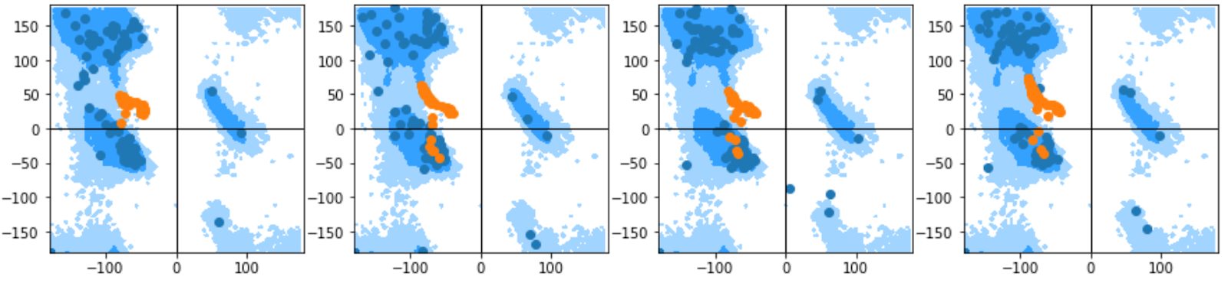
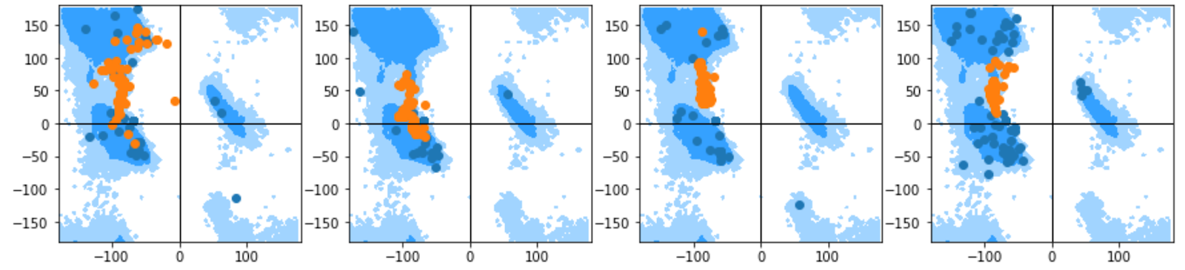
Autoregressive Prediction

Slide 20
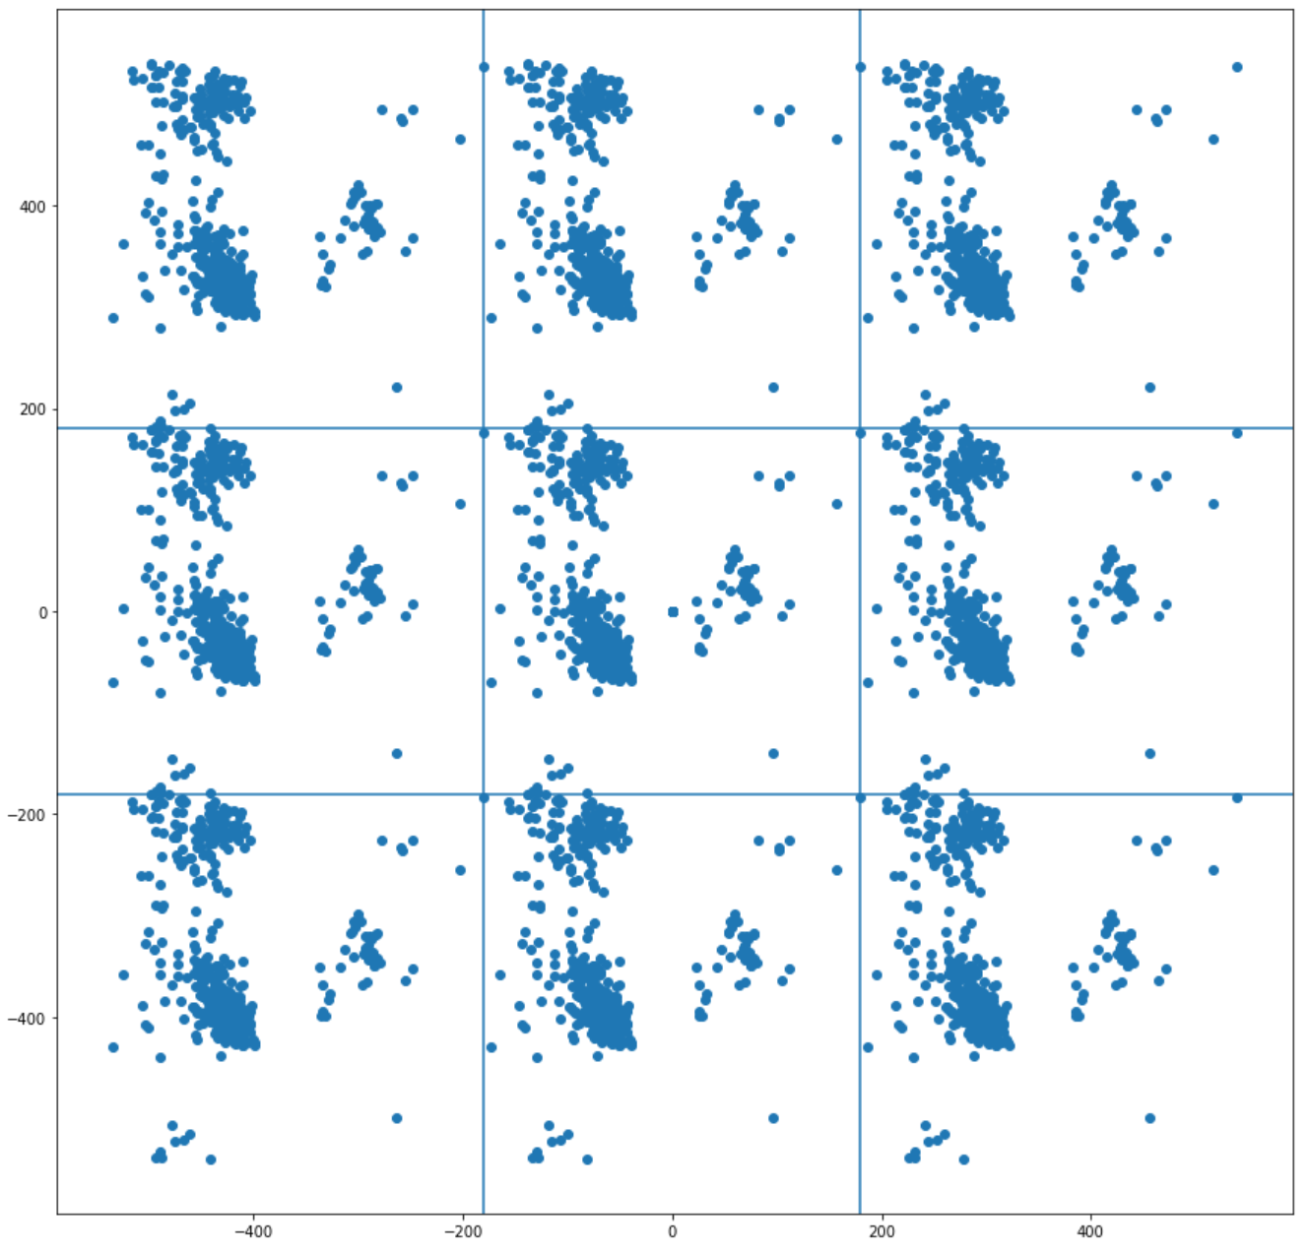
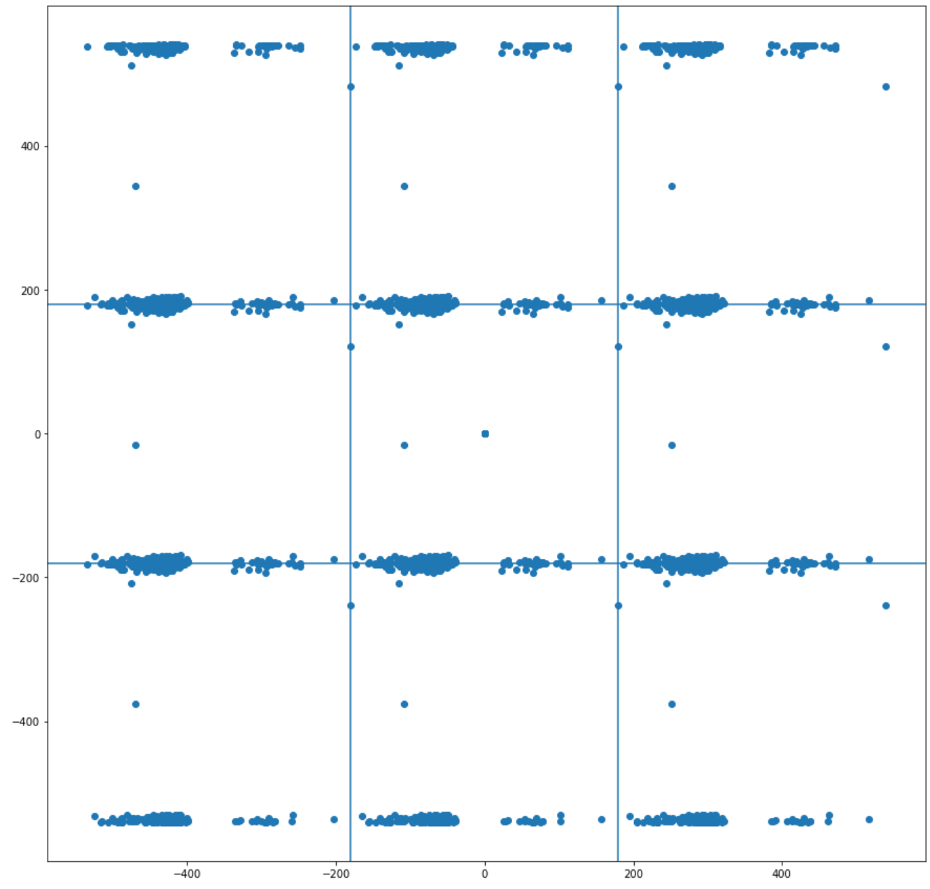
Periodicity

Slide 21
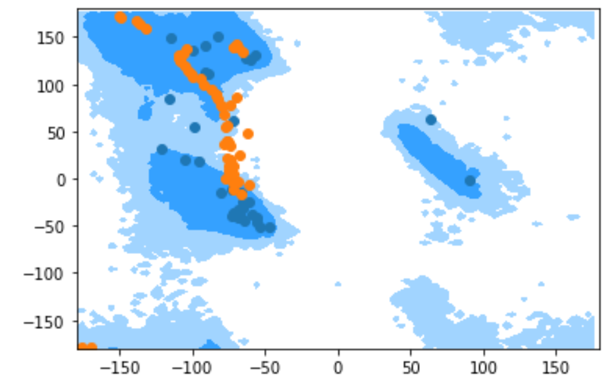
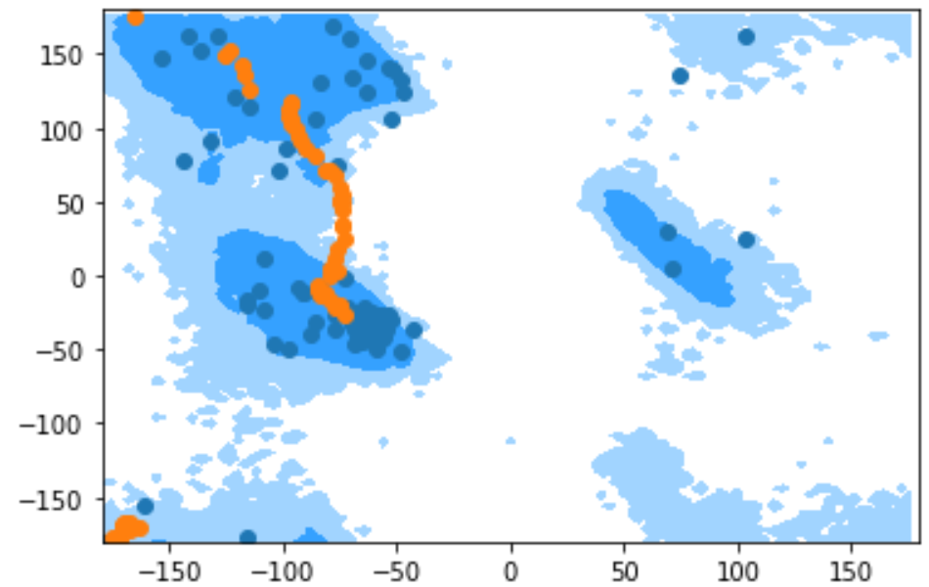
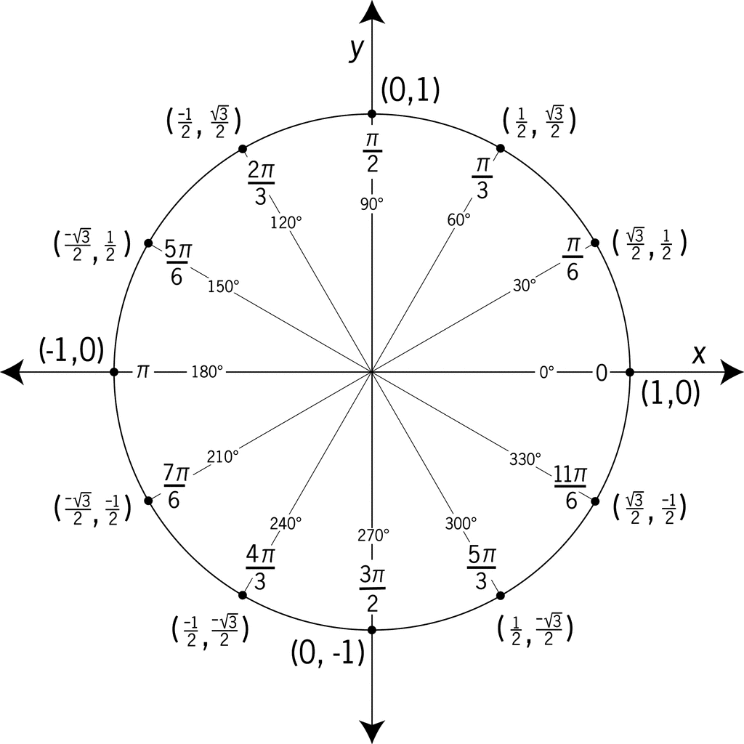
Representation
Inputs are cos(𝜃) and sin(𝜃), factored as p(𝜙_{i}, 𝜓_{i} , 𝜔_{i}) = p(𝜙_{i}) p(𝜓_{i}|𝜙_{i}) p(𝜔_{i} |𝜙_{i}, 𝜓_{i})

Slide 22
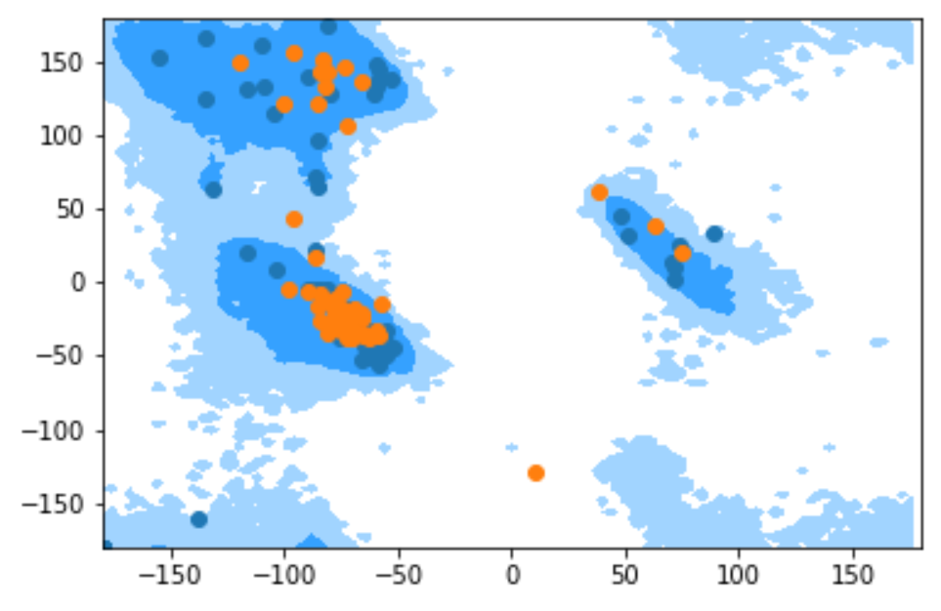
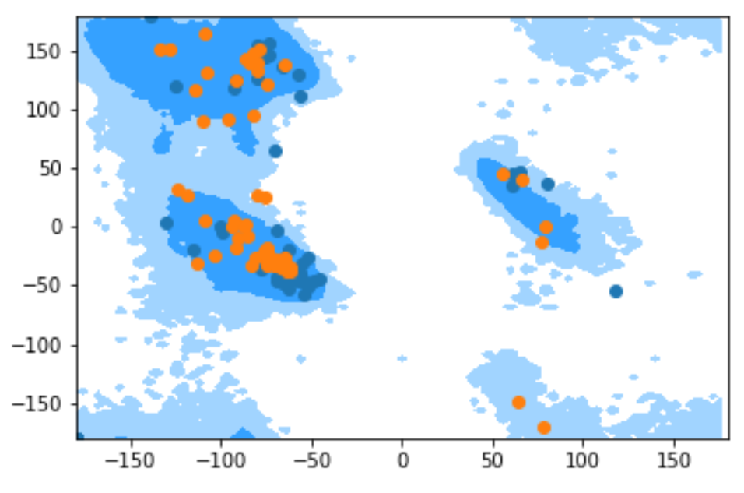
Representation + Tanh
Inputs are cos(𝜃) and sin(𝜃), factored as p(𝜙_{i}, 𝜓_{i} , 𝜔_{i}) = p(𝜙_{i}) p(𝜓_{i}|𝜙_{i}) p(𝜔_{i} |𝜙_{i}, 𝜓_{i})

Slide 23
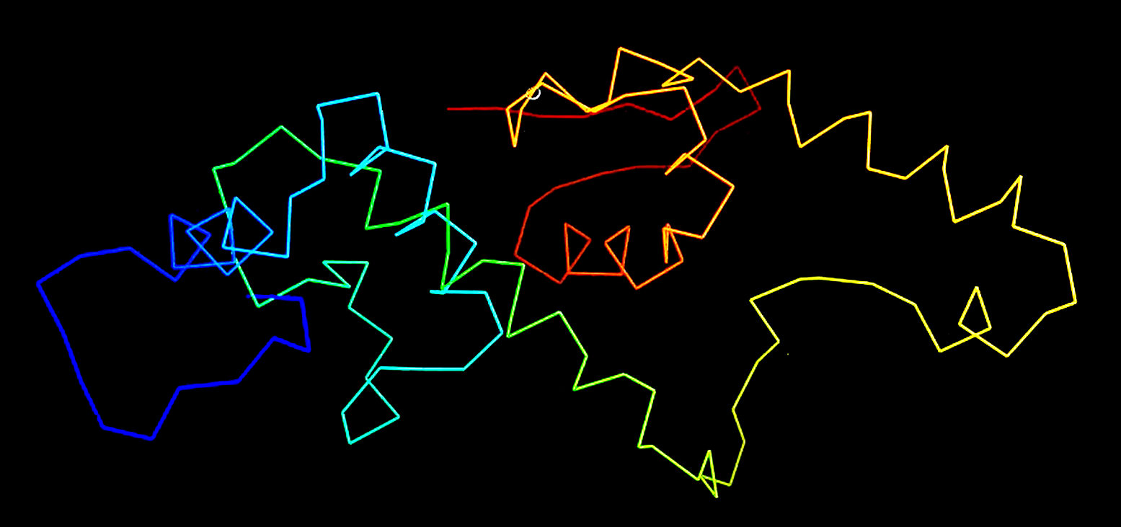
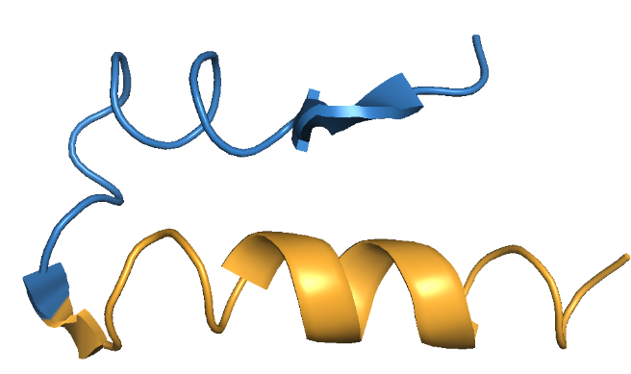
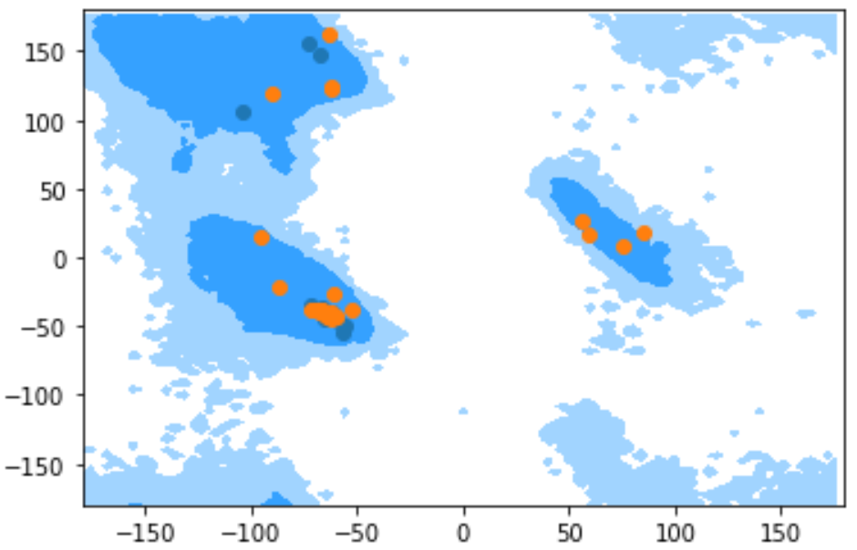
Backbone Samples

Slide 24
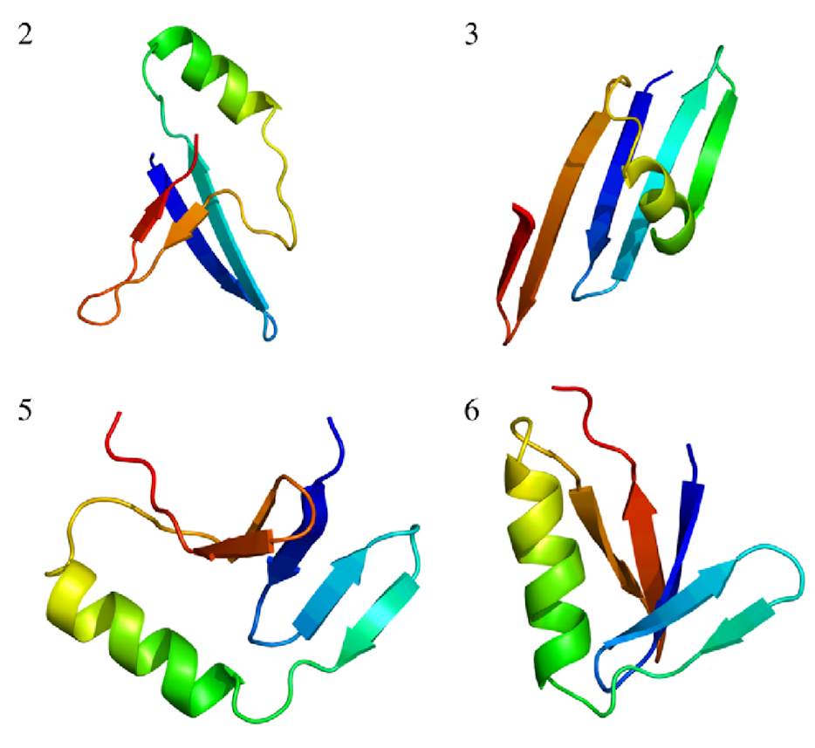
Related Work
Notes:
Hamelryck, Thomas, et al. "Potentials of mean force for protein structure prediction vindicated, formalized and generalized." PloS one 5.11 (2010): e13714.

Slide 25
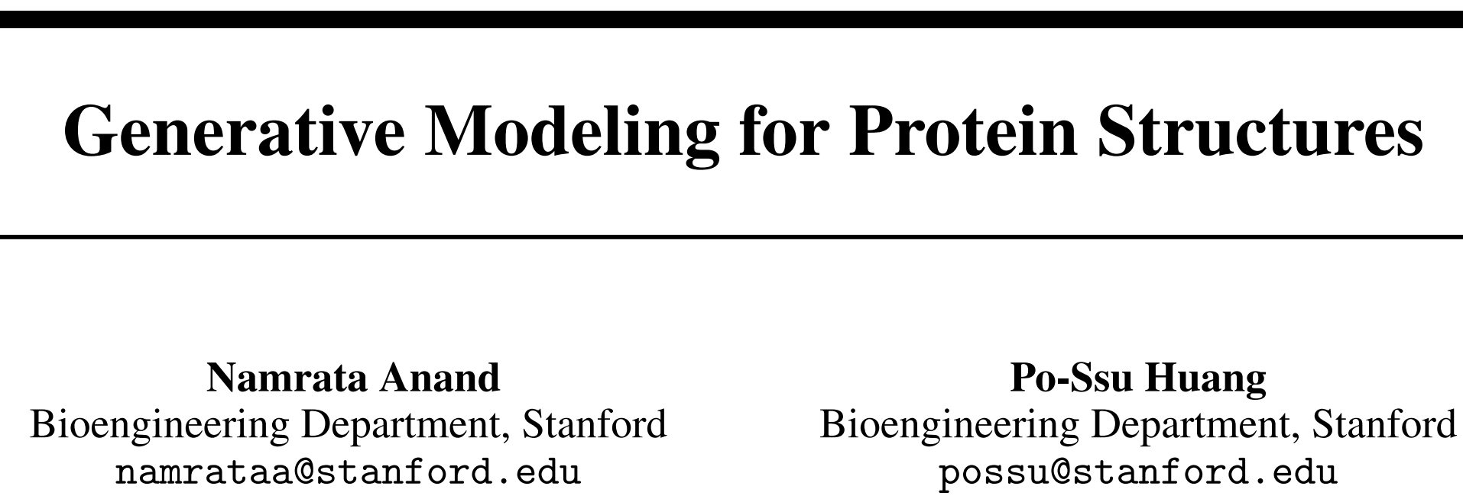
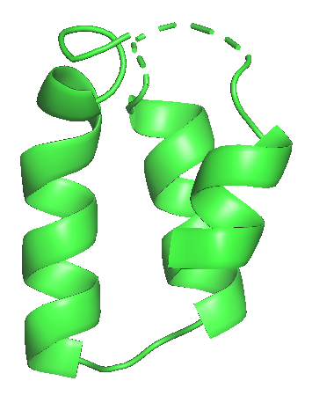
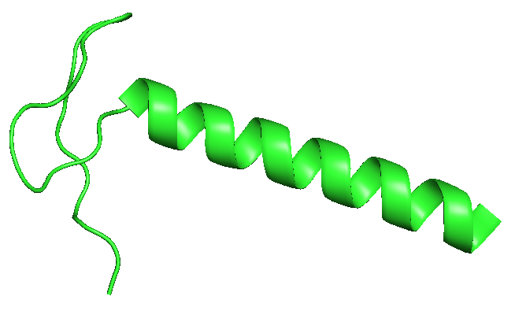
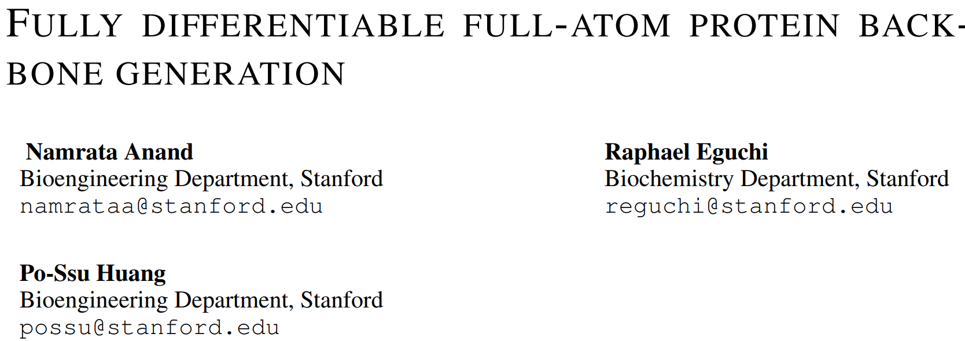
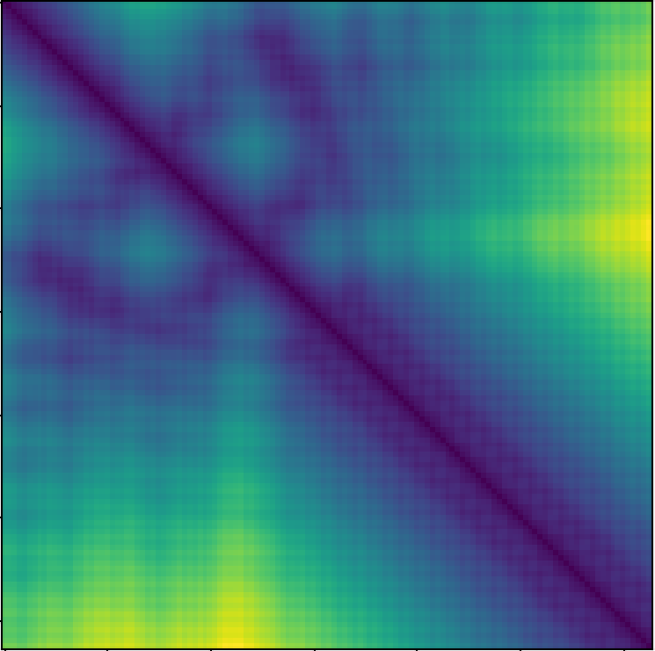
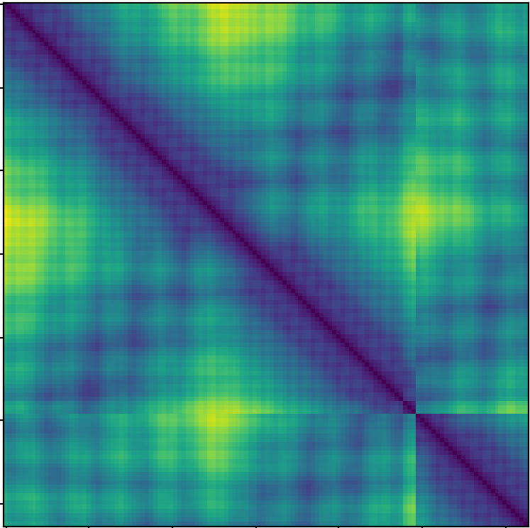
Distance Matrix

Slide 26
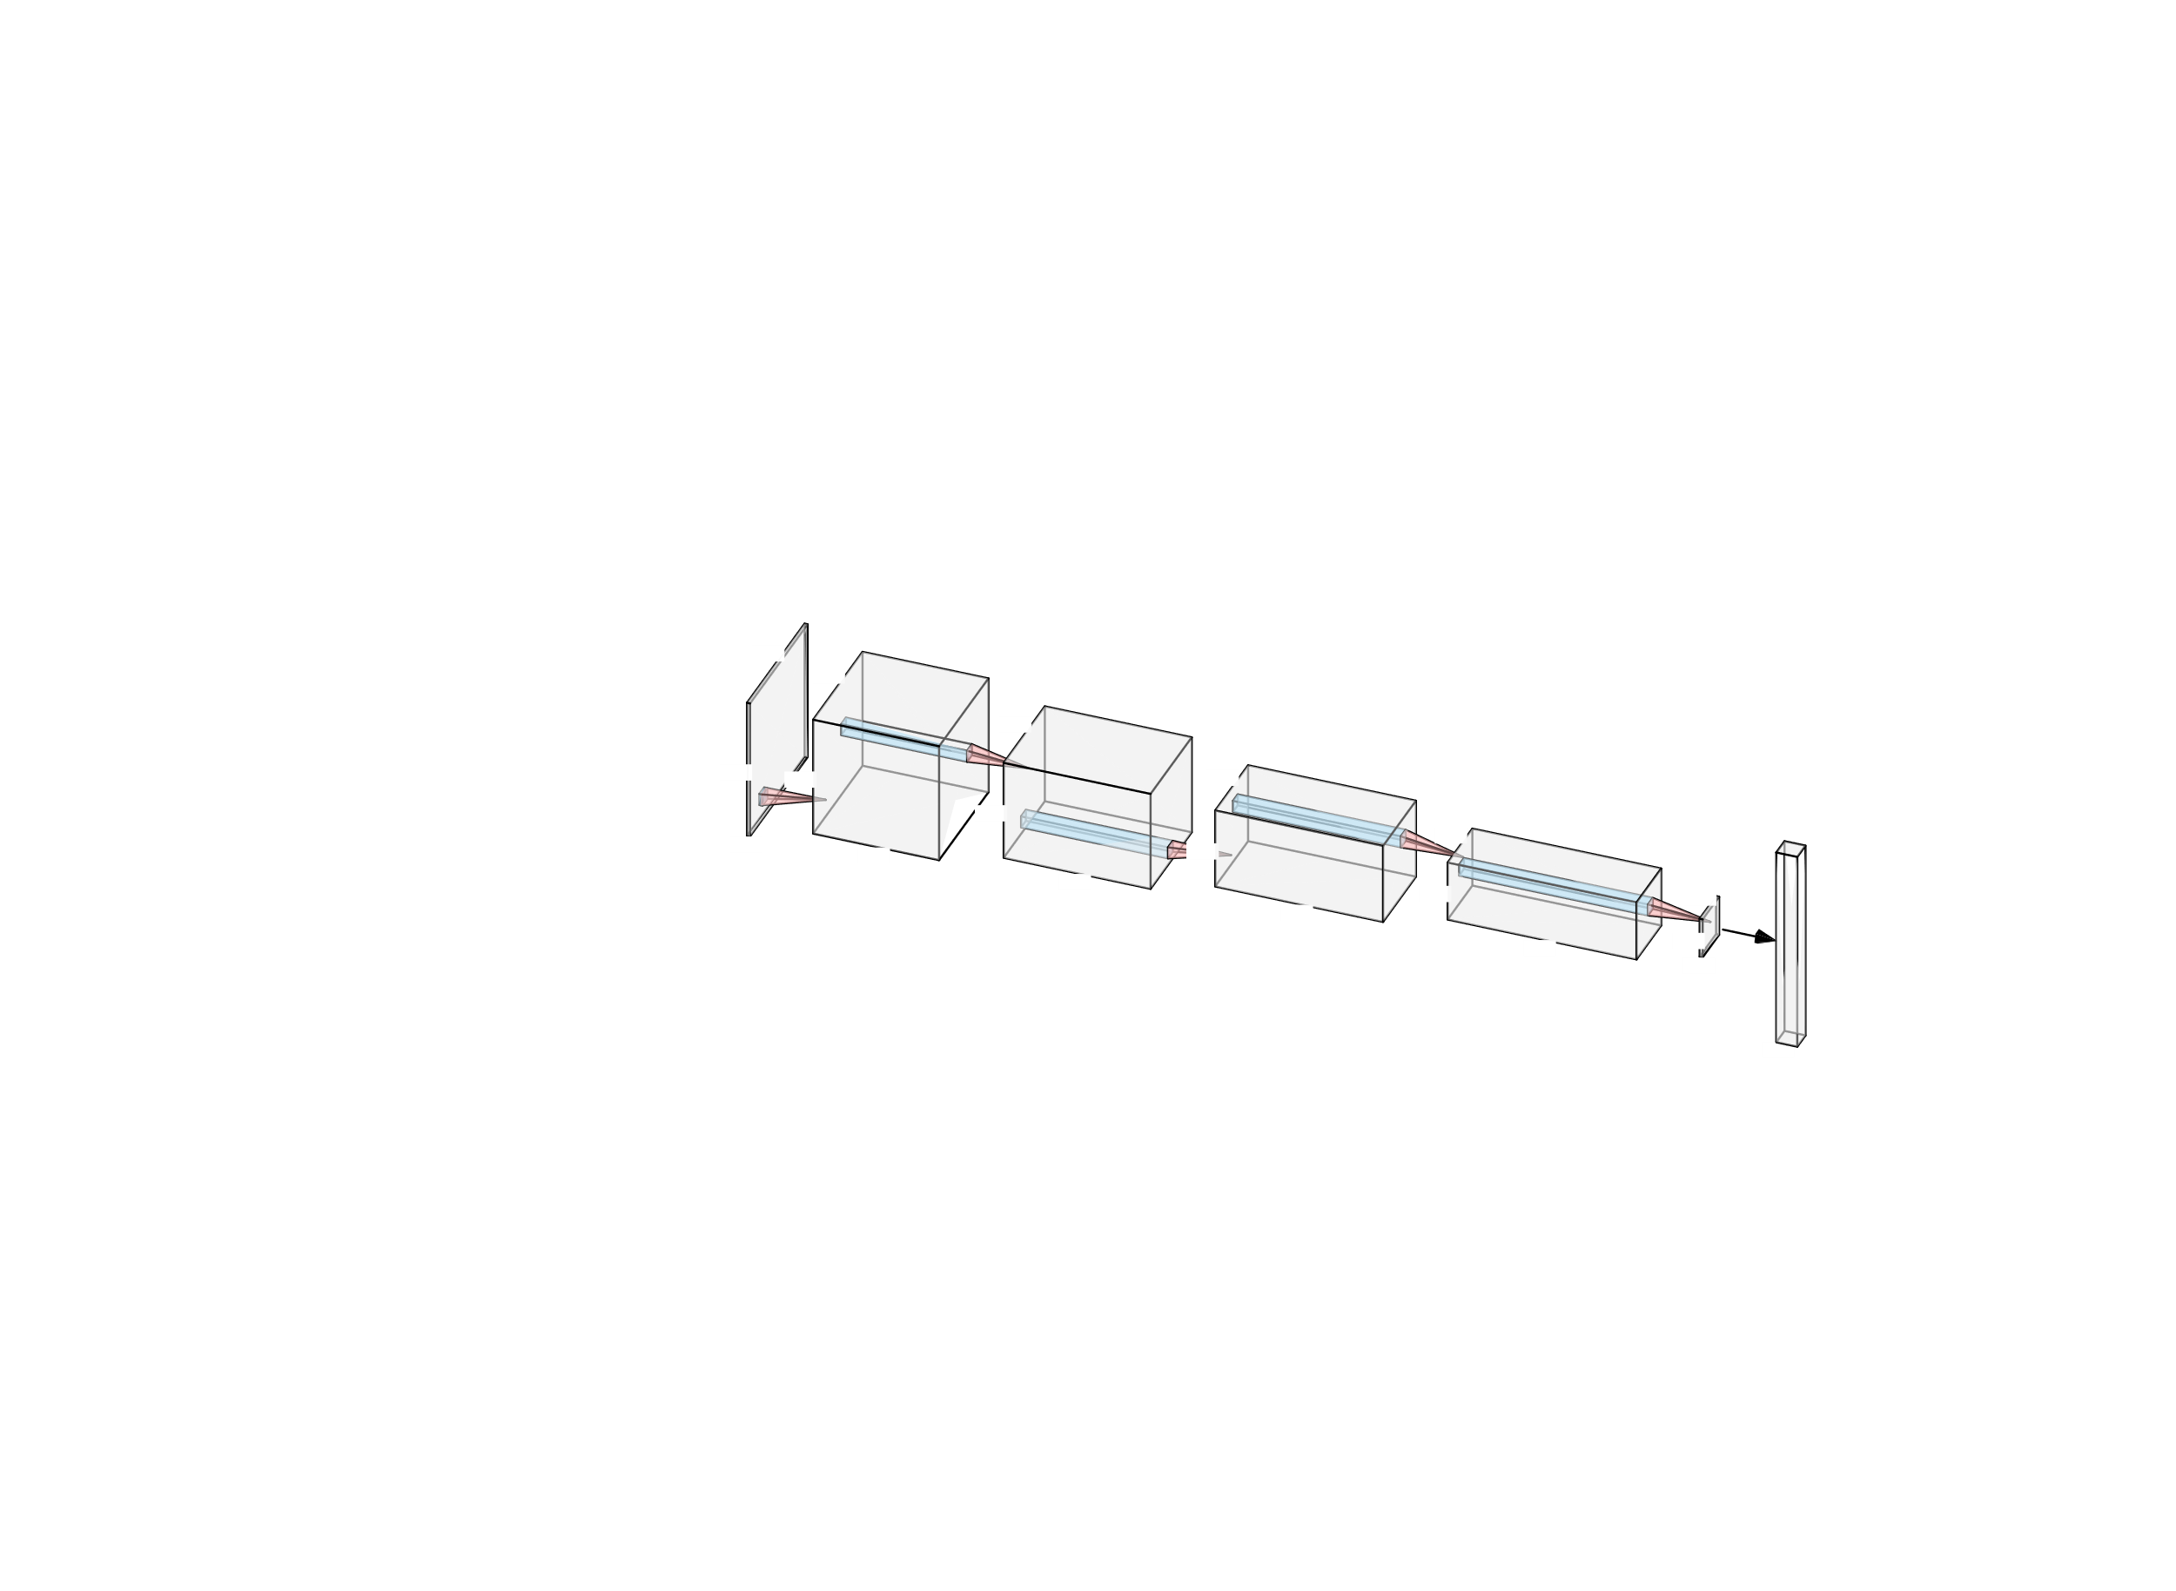
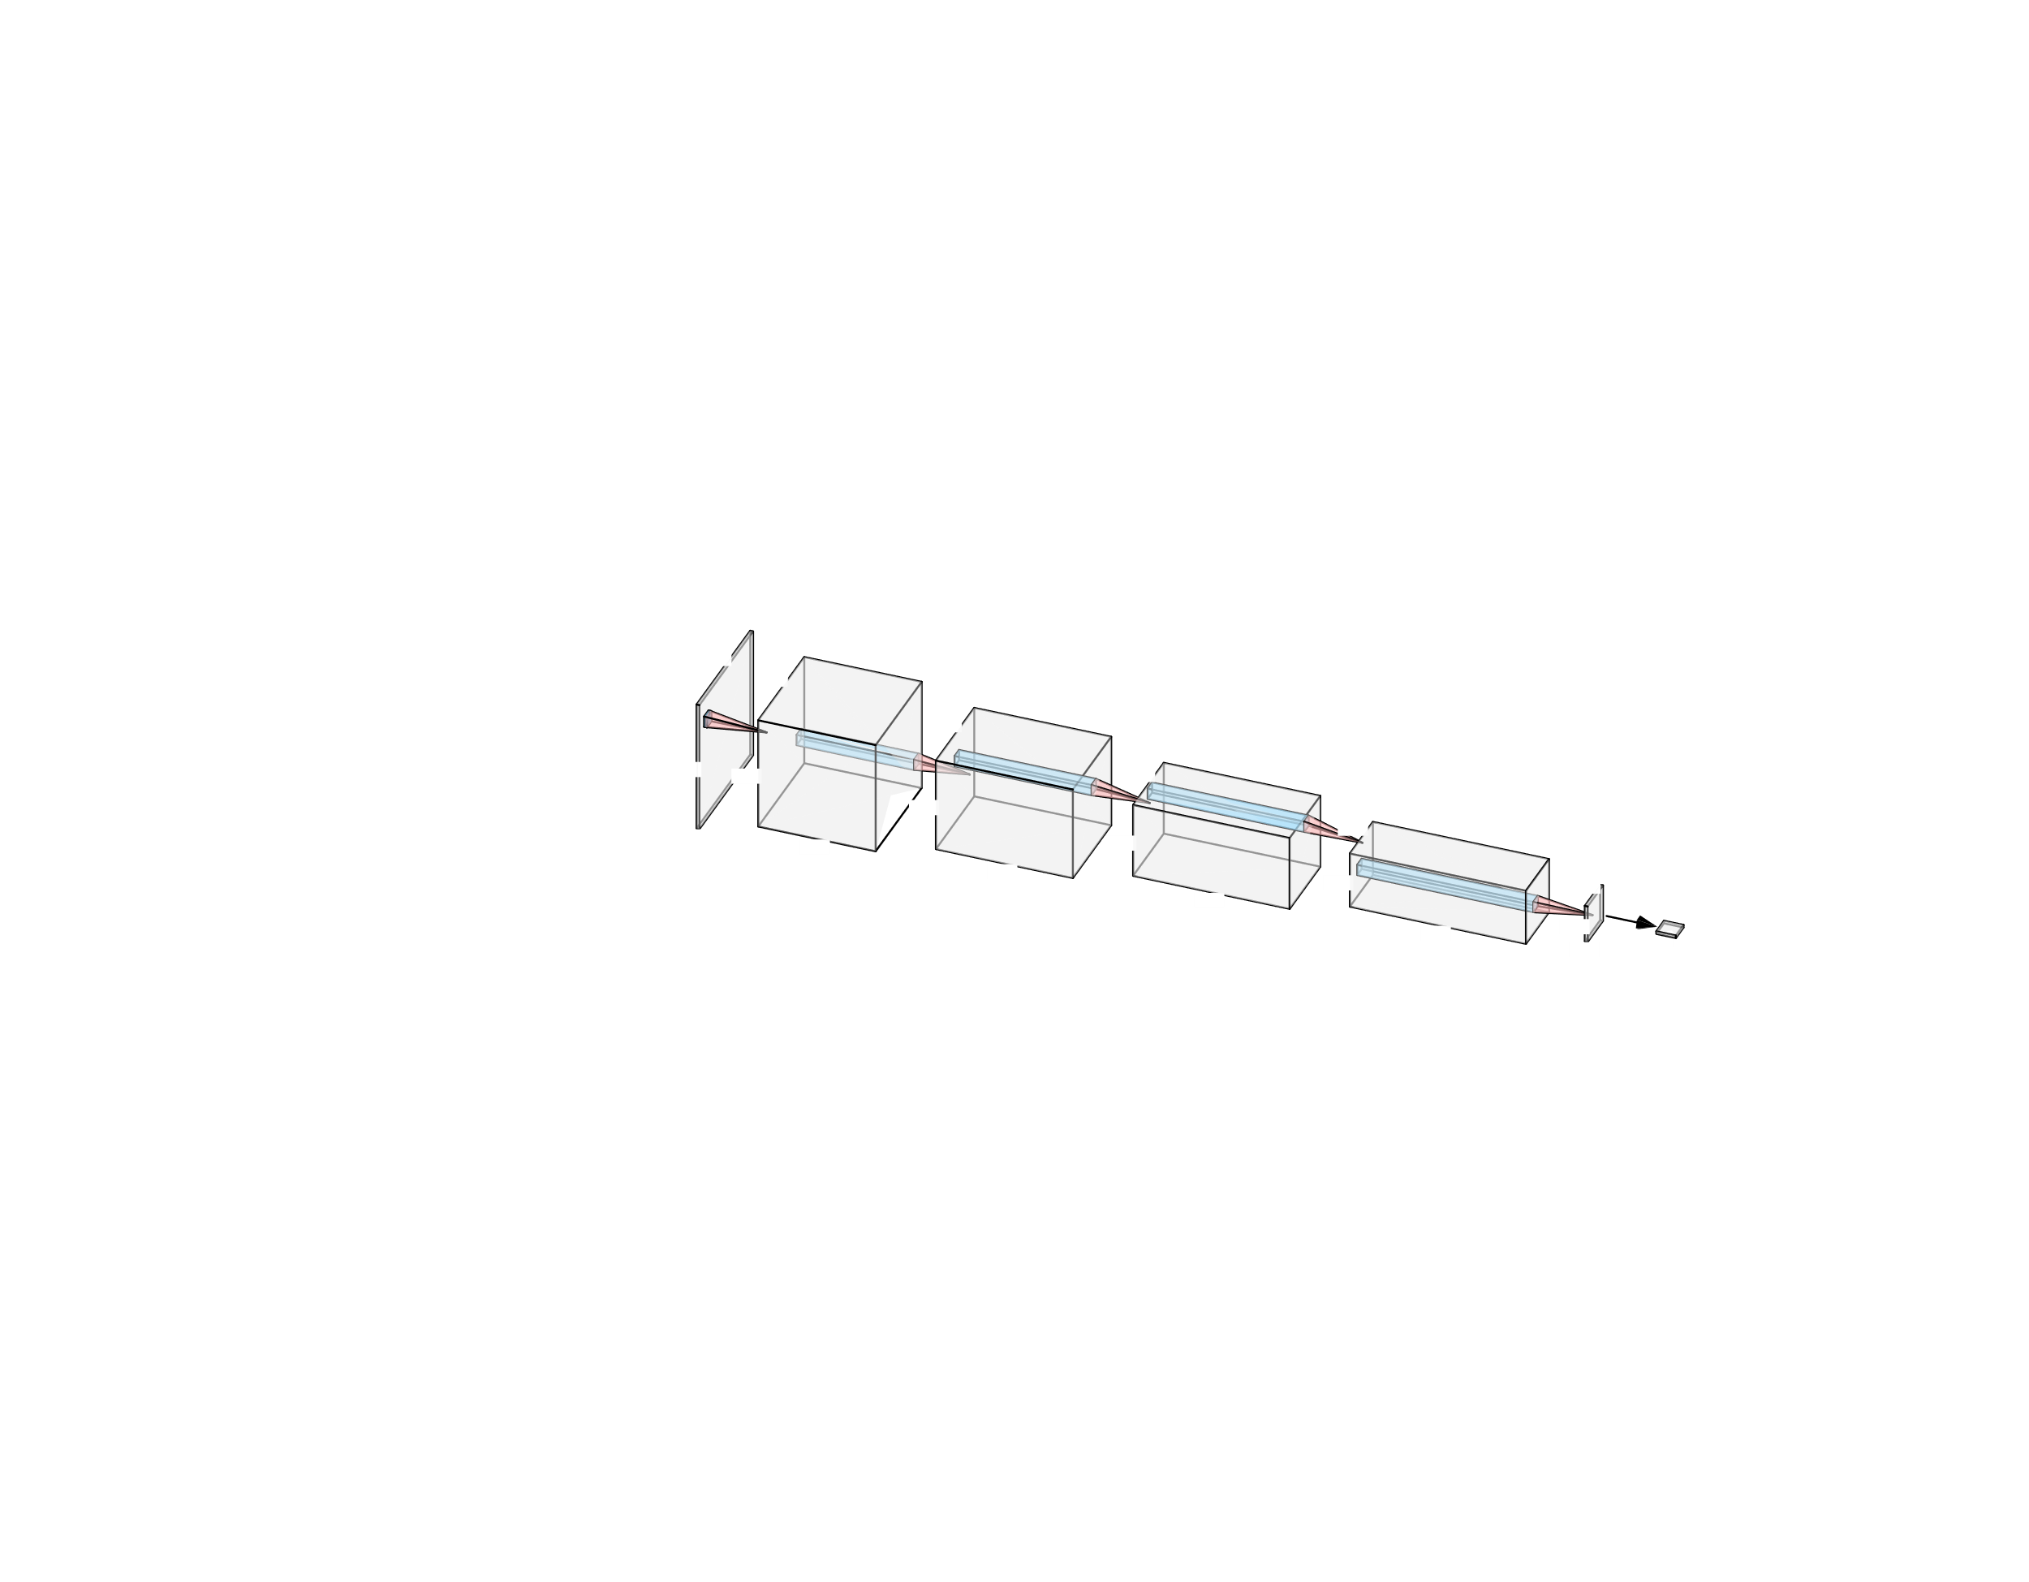
GAN
Generator
Discriminator

Slide 27
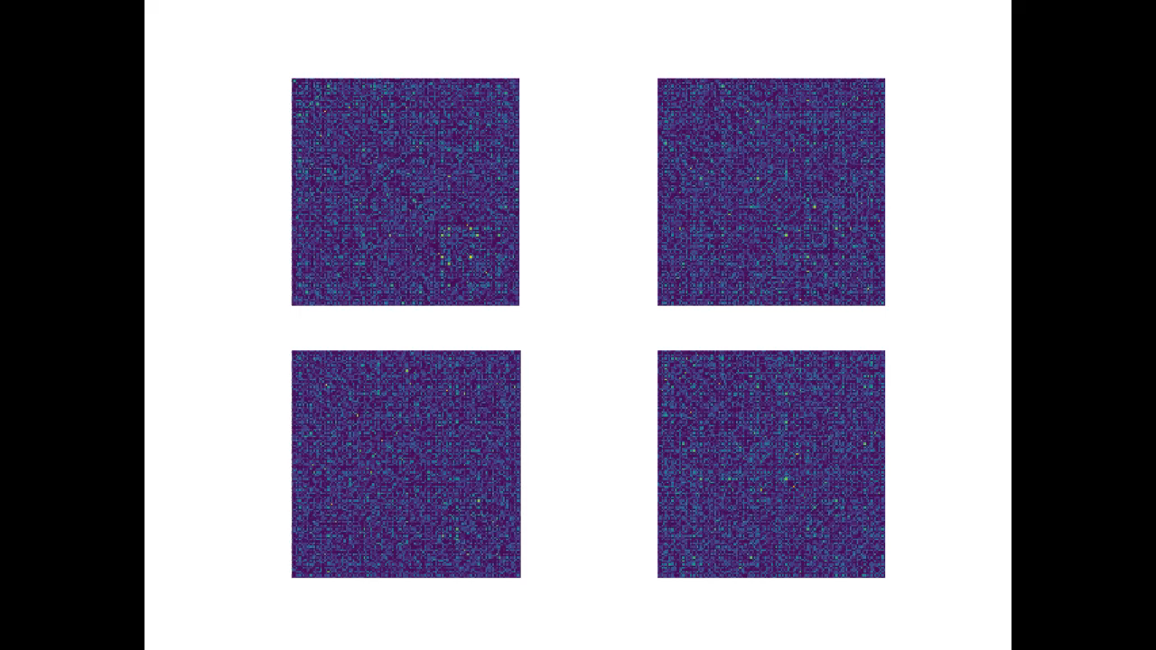
GAN Samples

Slide 28
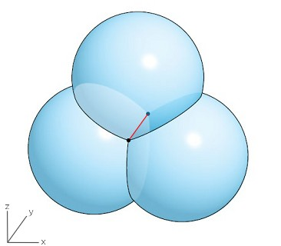
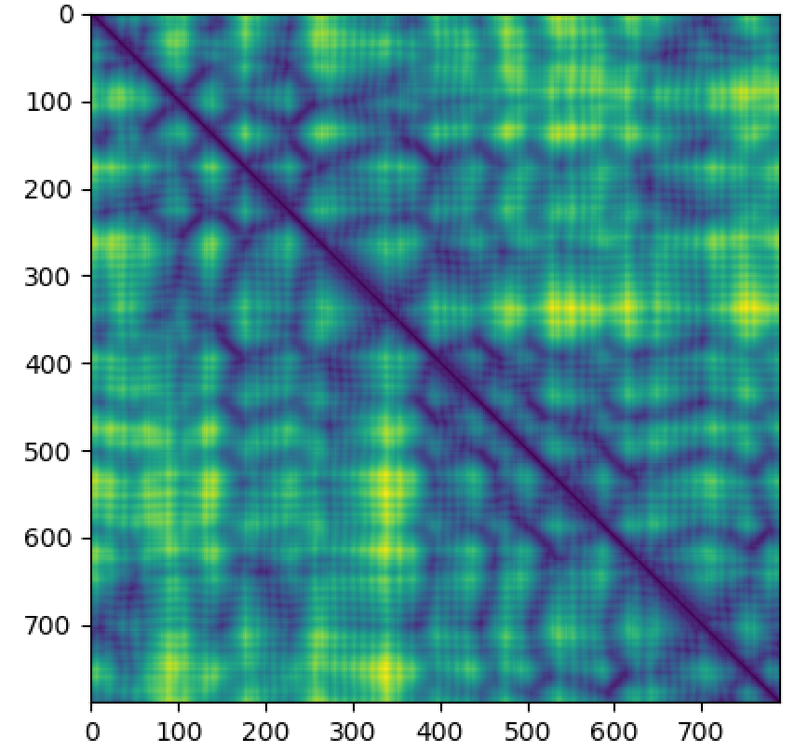
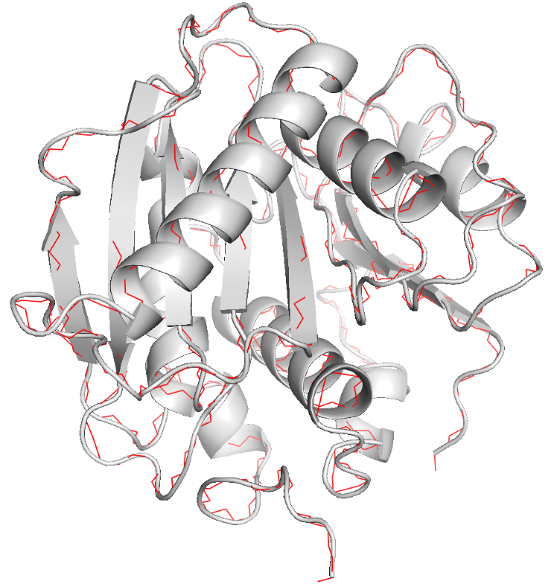
Contact Map to Coordinates
Given a perfect contact map, can use intersection of three spheres algorithm to reconstruct cartesian coordinates
Notes:
https://math.stackexchange.com/questions/3760072/length-of-line-segment-at-intersection-of-three-spheres

Slide 29

Immunoglobulin-VAE

Slide 30


Slide 31


Latent Space Sampling
Shape complementarity to SARS-CoV 2
Backbone design as constrained latent space optimization

Slide 32

3wx4 Mimic
Notes:
http://bioinformatics.org/molvis/phipsi/

Slide 33


3wx4 DNA Mimic
Only major groove mimic of currently known DNA mimics
Notes:
The T4 phage DNA mimic protein Arn inhibits the DNA binding activity of the bacterial histone-like protein H-NS

Slide 34


Docking
3wx4
3wx4
ArdA
Myc-Max
Myc-Max
Max-Max

Slide 35


MD Simulation Clusters
5 most populated cluster centers

Slide 36



Rosetta Design

Slide 37


Symmetries
Suggested by Albert, consider a Max-Max / 3wx4 homodimer complex
Reduces from a four-protein to a two-protein system
3wx4 dimer interacts with TF helices symmetrically

Slide 38

Max-Max-3wx4 Docking

Slide 39



Myc and Max
Myc overexpression is a feature of many cancers
Enforced Max expression blocks Myc activity
Max-Max homodimer competes with Myc-Max to bind 5’-CACGTG-3’
MD simulation for Max-Max-3wx4 system running

Slide 40

MaSIF
Notes:
http://bioinformatics.org/molvis/phipsi/

Slide 41

MaSIF - Motivation
Given a DNA mimic protein, where should we dock Myc-Max?
Are there other surfaces in the PDB that can bind Myc-Max?

Slide 42

MaSIF Search
Molecular Surface Interaction Fingerprints

Slide 43


Slide 44




MaSIF Search on 5’-CACGTG-3’
MSMS
Electron Donors/Acceptors
Electrostatics
Generate fingerprints

Slide 45



MaSIF Search on DNA Mimics

Slide 46


MaSIF Search on 3wx4

Slide 47

DNA Mimics vs Random Proteins
Blue: DNA Mimics
Orange: Random proteins
Normalized Frequency
Euclidean distance

Slide 48

MaSIF-Search on PDB
Notes:
Data available here: https://drive.google.com/file/d/1nObO4aJnYJxLQHfcC9OAJs2WoNMmnpLS/view?usp=sharing

Slide 49
References
Alammar, Jay. The Illustrated Transformer, 27 June 2018, jalammar.github.io/illustrated-transformer/.
Alford, Rebecca F., et al. "The Rosetta all-atom energy function for macromolecular modeling and design." Journal of chemical theory and computation 13.6 (2017): 3031-3048.
Anand, Namrata, and Possu Huang. "Generative modeling for protein structures." Advances in Neural Information Processing Systems. 2018.
Anand, Namrata, Raphael Eguchi, and Po-Ssu Huang. "Fully differentiable full-atom protein backbone generation." (2019).
Conacci-Sorrell, Maralice, Lisa McFerrin, and Robert N. Eisenman. "An overview of MYC and its interactome." Cold Spring Harbor perspectives in medicine 4.1 (2014): a014357.
Crooks, Gavin E., et al. "WebLogo: a sequence logo generator." Genome research 14.6 (2004): 1188-1190.
DeLano, Warren L. "Pymol: An open-source molecular graphics tool." CCP4 Newsletter on protein crystallography 40.1 (2002): 82-92.
De Vries, Sjoerd J., Marc Van Dijk, and Alexandre MJJ Bonvin. "The HADDOCK web server for data-driven biomolecular docking." Nature protocols 5.5 (2010): 883.
Eguchi, Raphael R., et al. "Ig-VAE: Generative Modeling of Immunoglobulin Proteins by Direct 3D Coordinate Generation." bioRxiv (2020).
Gainza, Pablo, et al. "Deciphering interaction fingerprints from protein molecular surfaces using geometric deep learning." Nature Methods 17.2 (2020): 184-192.
Gowers, Richard J., et al. MDAnalysis: a Python package for the rapid analysis of molecular dynamics simulations. No. LA-UR-19-29136. Los Alamos National Lab.(LANL), Los Alamos, NM (United States), 2019.

Slide 50
References
Guntas, Gurkan, Carrie Purbeck, and Brian Kuhlman. "Engineering a protein–protein interface using a computationally designed library." Proceedings of the National Academy of Sciences 107.45 (2010): 19296-19301.
Ho, Chun-Han, et al. "The T4 phage DNA mimic protein Arn inhibits the DNA binding activity of the bacterial histone-like protein H-NS." Journal of Biological Chemistry 289.39 (2014): 27046-27054.
Ingraham, John, et al. "Learning Protein Structure with a Differentiable Simulator." ICLR. 2019.
Kozakov, Dima, et al. "The ClusPro web server for protein–protein docking." Nature protocols 12.2 (2017): 255.
McMahon, Stephen A., et al. "Extensive DNA mimicry by the ArdA anti-restriction protein and its role in the spread of antibiotic resistance." Nucleic acids research 37.15 (2009): 4887-4897.
Paszke, Adam, et al. "Automatic differentiation in pytorch." (2017).
Radford, Alec, et al. "Language models are unsupervised multitask learners." OpenAI Blog 1.8 (2019): 9.
Ramachandran, G. N., Sasisekharan V. Conformation of polypeptides and proteins. Adv Protein Chem. 1968;23:283- 438. PMID:4882249
Sillitoe, Ian, et al. "CATH: expanding the horizons of structure-based functional annotations for genome sequences." Nucleic acids research 47.D1 (2019): D280-D284.
Van Der Spoel, David, et al. "GROMACS: fast, flexible, and free." Journal of computational chemistry 26.16 (2005): 1701-1718.
Wang, Hao‐Ching, et al. "New paradigm of functional regulation by DNA mimic proteins: recent updates." IUBMB life 71.5 (2019): 539-548.

Slide 51






Acknowledgements
Philip Kim
Pedro Alberto Valiente Flores
Albert Perez Riba
Vincent Lee
Alexey Strokach
Carles Corbi
David Becerra
Han Wen
Fan Shen
Yuju Lee
Qiao Fang
Osama Abdin
David Becerra
Satra Nim
Mac Mok

